Slide 1
Solar initiative
Parkland fuels

Slide 2
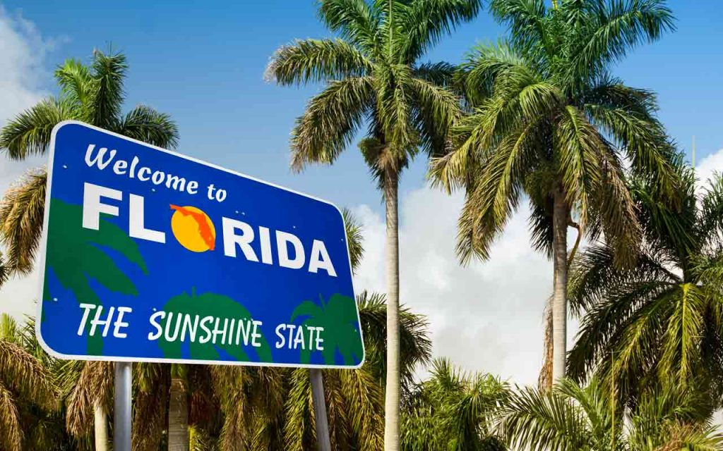
Florida Scope
National ranking
5th installed solar capacity
Energy
⅔ of energy comes from Natural Gas
Dominated by NG, Coal and Nuclear
Solar arena dominated by utilities
Laws
Lags heavily in pro-solar laws

Slide 3
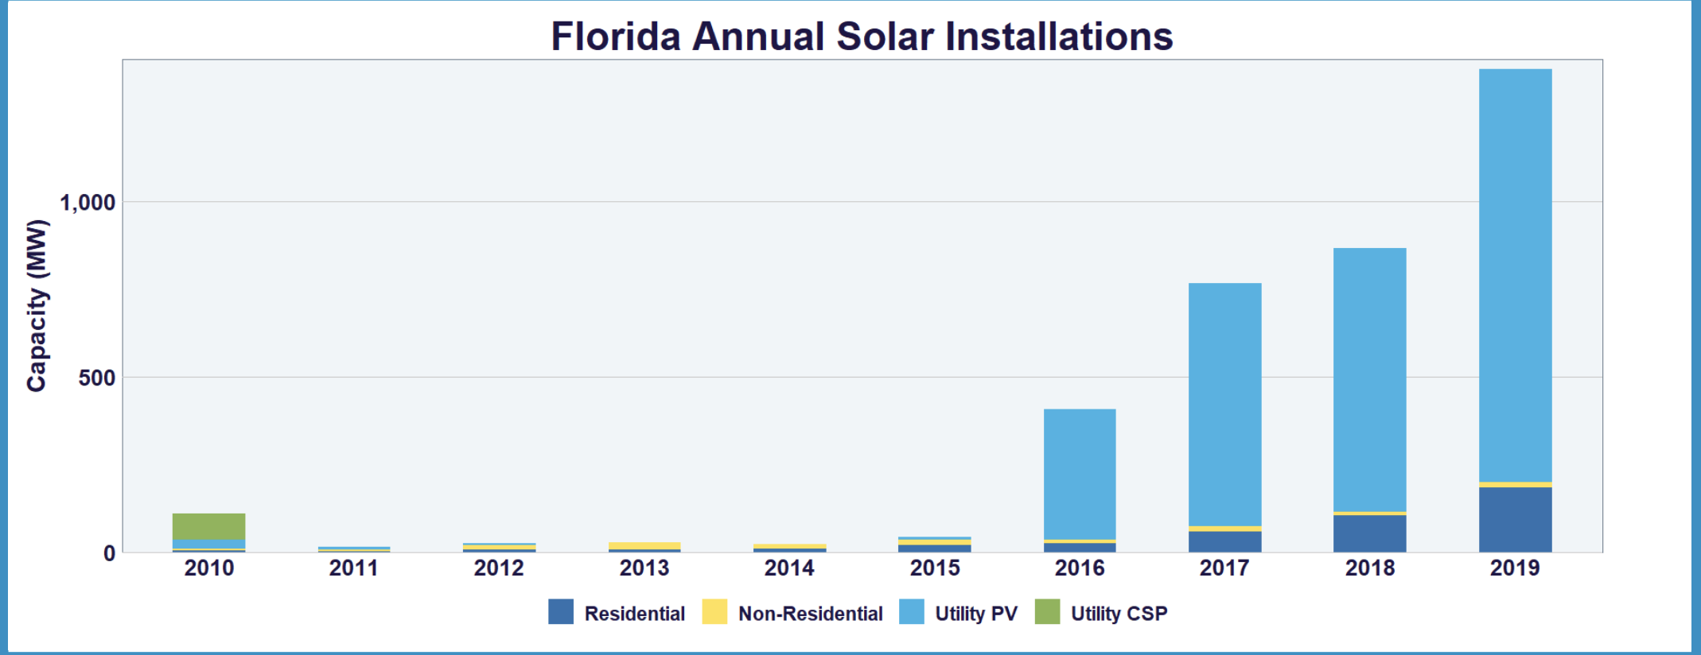
Florida Scope
Jobs
12,202 jobs
584 companies
81 manufacturers
304 installers/developers
199 other
Utilities
Consultant

Slide 4
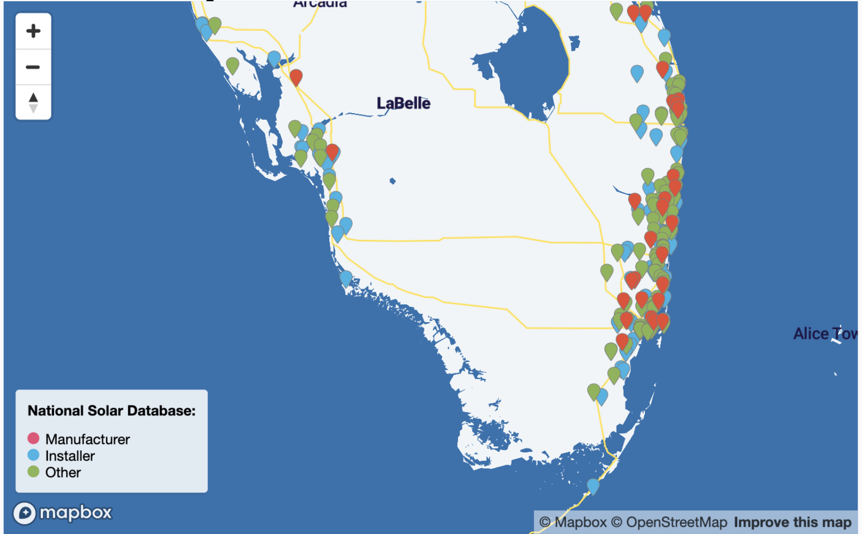
Solar companies in florida
Notes:
There are alot of solar companies in florida, This is just a screenshot I took from the SEIA website.

Slide 5
Laws / Government
26% federal Tax credit (2019 = 30, 2021 = 21, 2022 = 10)
Property tax
100% property tax exemption for residential
80% for non-residential properties (explore mote)
Sales tax exemption
Applies to rental, use, consumption, distribution, storage tax
DOES NOT allow solar PPAs (one of four states)
You have to buy electricity from a utility
Net metering
You can sell excess energy to utilities and get credit for that energy
Deters residential solar storage
Solar loans/leases
No RPS (less incentives from utilities for homeowners to make the switch)
Notes:
RPS(renewable portfolio standard)
Utilties are fined if a certain portion of the state’s energy is not renewable by a certain date
PPA(power purchase agreement)
Customer purchases power from you

Slide 6
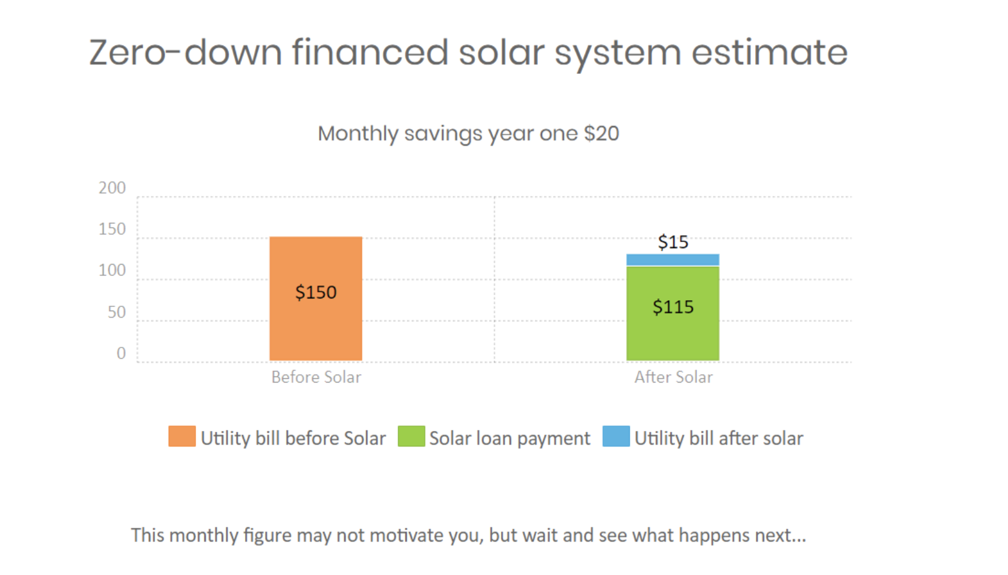
Application of solar lease

Slide 7
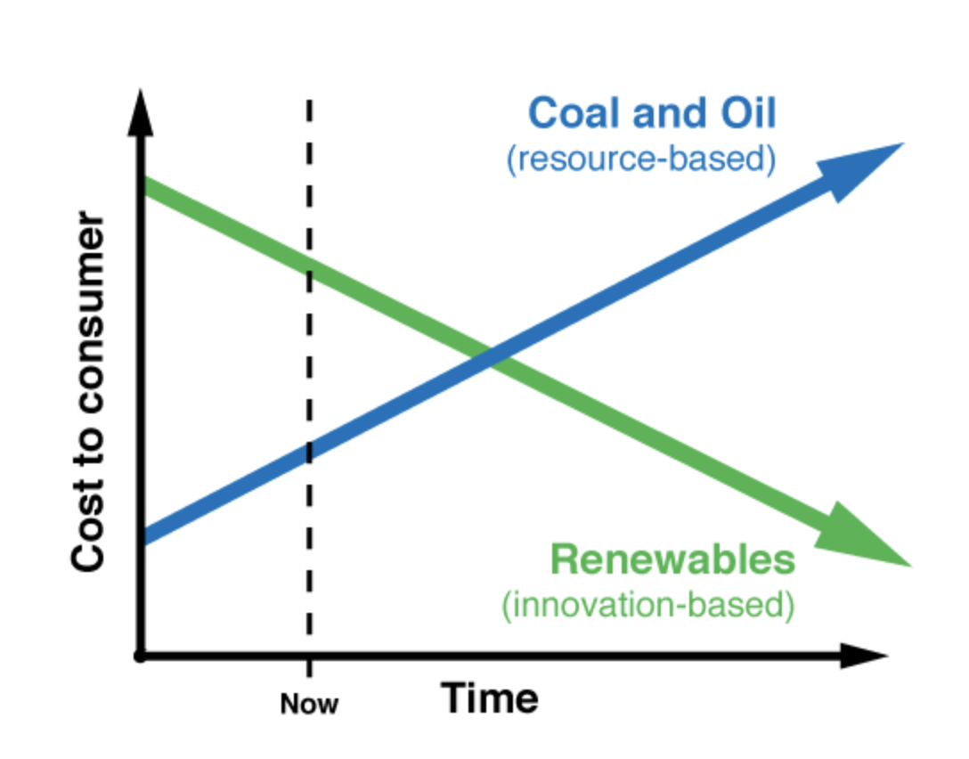
Energy/Solar Market and Future outlook
Solar is cheaper than coal and gas
Coal plants are old
Solar investment tax credits
Was 30%
2020 = 26%
2021 = 22%
Today Solar Modules are only about 40% of total costs for a utility scale solar plant
Notes:
It is cheaper to build a solar or wind plant than the ongoing costs of coal plants. They are old plants
It’s cheaper to build a new renewable site than build a gas site
Unfortunately, I will have to do some deeper digging to find numbers on the levelized cost of energy with solar vs fossil fuels
But Renewable price will go down in the future while FF will go up.

Slide 8
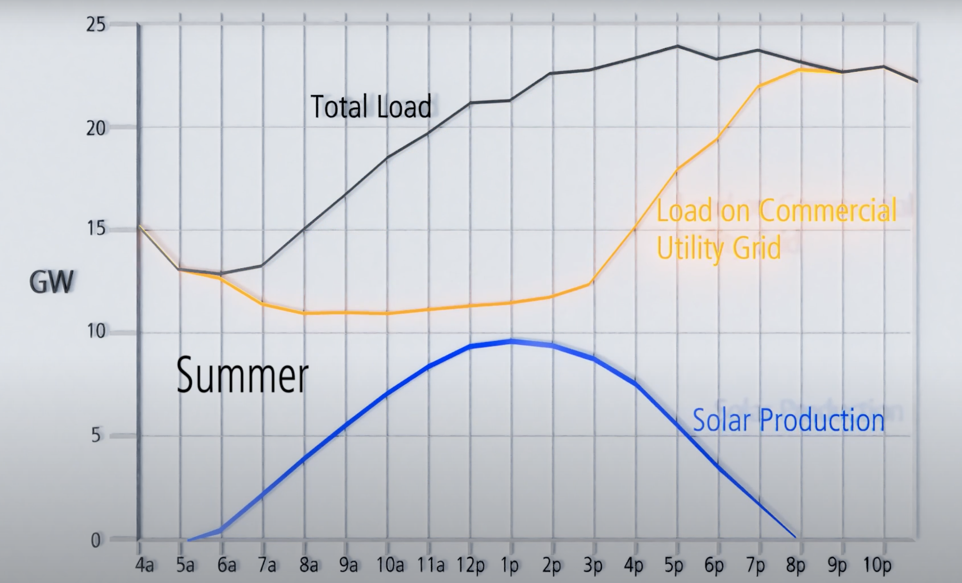
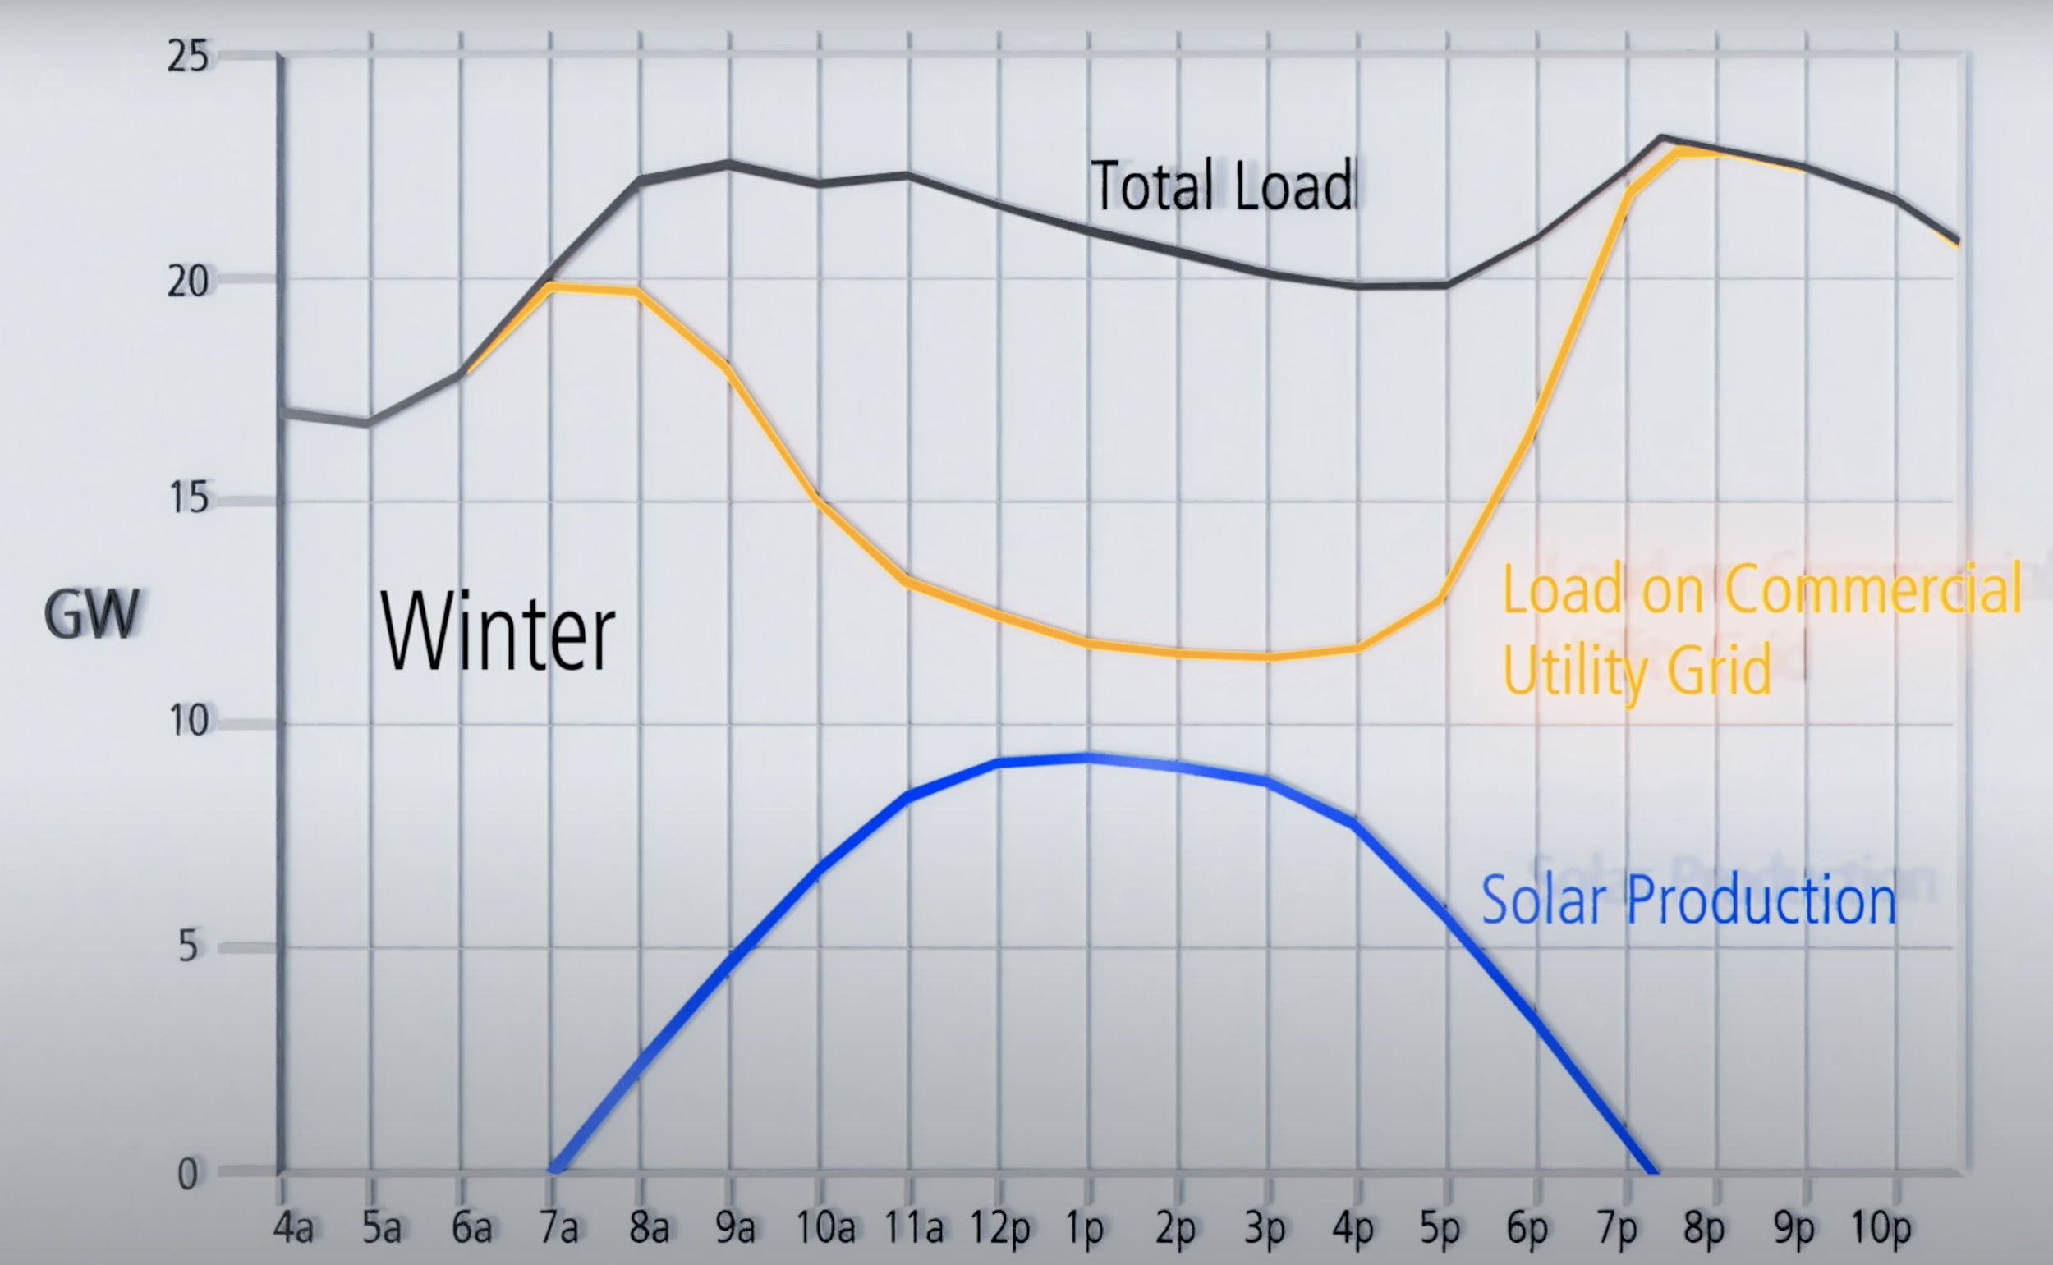
Energy/Solar Market
Problems with renewables
Duck curve
Notes:
Just some background info on renewables. More specifically solar. There is a phenomenon known as the duck curve that is caused by variations in energy demand. Utilities have to balance between energy supply and energy demand. Renewables make that harder.
There is a difference between available power and dispatchable.
This is shaping the power grid. For example:
Sole solar power utilities will usually sell power during the day when there is peak power and buy power later in the day when it is cheaper.
Another case is pumped-hydro power plants. In times of low energy demand, the energy is used to pump water uphill to a reservoir. That same water is then released in time of high energy demand to drive a turbine for energy.

Slide 9
Utility scale vs Distributed scale
Utility
Better option, modules are only about 40% of total costs.
Can utilize solar trackers which will provide 30% more energy
Cheaper than gas and coal plants
Huge upfront costs, and financing
Distributed
Typically refers to commercial or residential installations
Due to labor costs, retrofitting, and solar irradiation, Profitability is hard
Cost is main factor for solar adoption.
More expensive per watt than utility
The cost has to compete with the cost for grid energy.
Net metering laws
Utilities HAVE to buy back excess solar power at retail price
Solar customers avoid paying for all of the fixed costs of the grid that delivers power
Loss to utilities = transfer of costs to other customers
Notes:
Retrofit Roofing Systems consist of adding sub-structural components to the existing flat roof to build a slope into the structure. Basically getting the roof ready for installation of solar
Distributed solar models are usually: total upfront or solar lease
One fundamental problem of distributed scale that could not be maintained is net metering.
Net metering is when utilities have to buy back excess solar power at retail price
Since they are being paid retail price, it does not take into account the grid costs for transferring power, infrastructure and other fixed costs for the utilities.
There is a loss to the utilities which is transferred to non-solar customers.
There is reform happening right now as of 3rd quarter 2019.
Another holistic consequence of distributed is that it destabilizes the grid. Not a future growth area unless there is solar+storage. Which would be another problem due to increased costs..

Slide 10
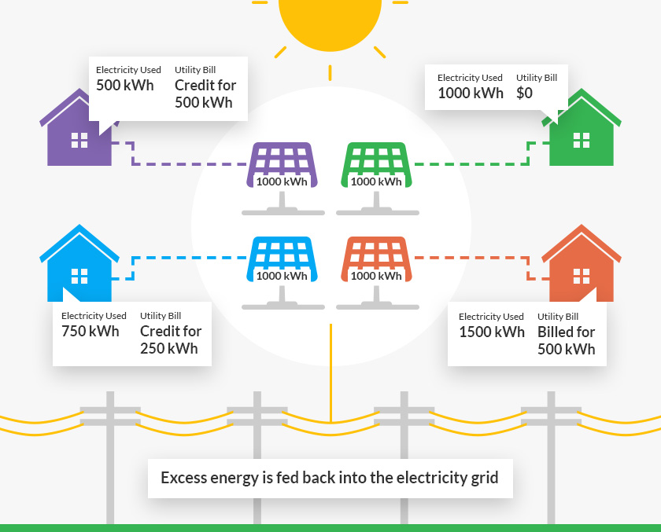
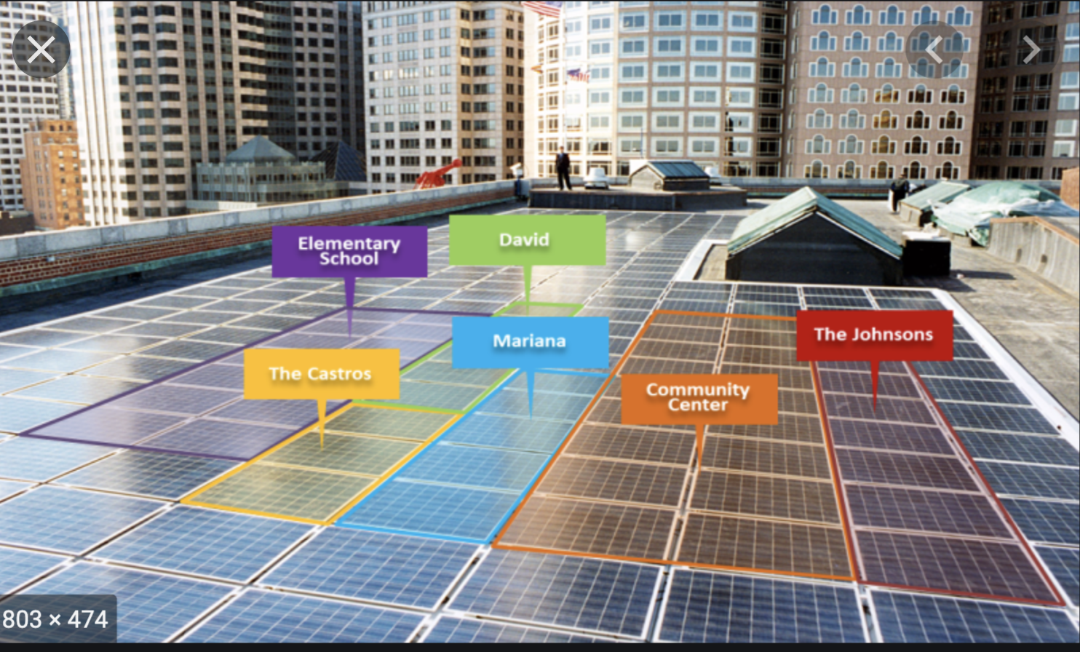
Best Future Outlook
Community Solar
Blend between utilities and distributed solar
Solar+Storage
Distributed: Can take consumer off-grid
Utilities: can provide dispatchable power
Solution to storage is next goldmine
Notes:
Li-Ion batteries are generally sufficed nowadays.
We are limited by the tech of our time.
Visionary predicted that …...

